Slide 1

01.
Foundational Concepts
Copyright © 2025 Accenture. All rights reserved.
1

Slide 2
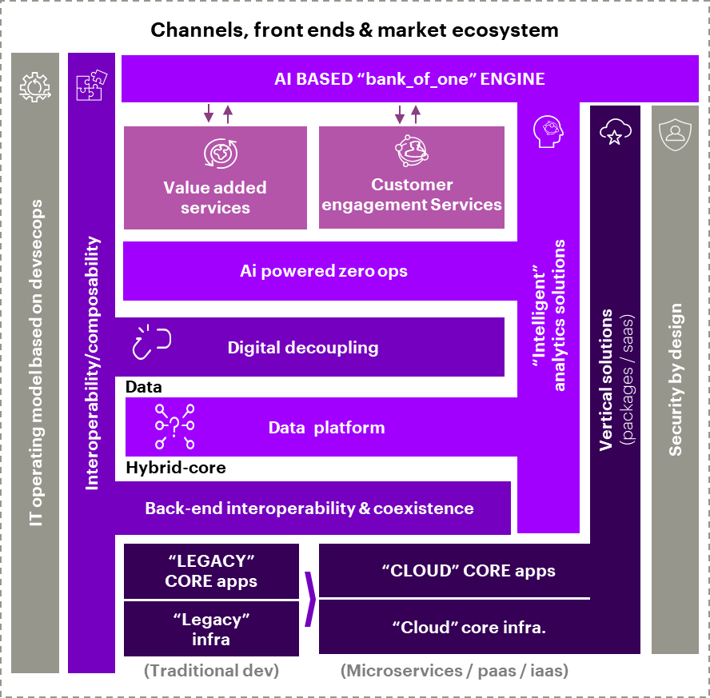
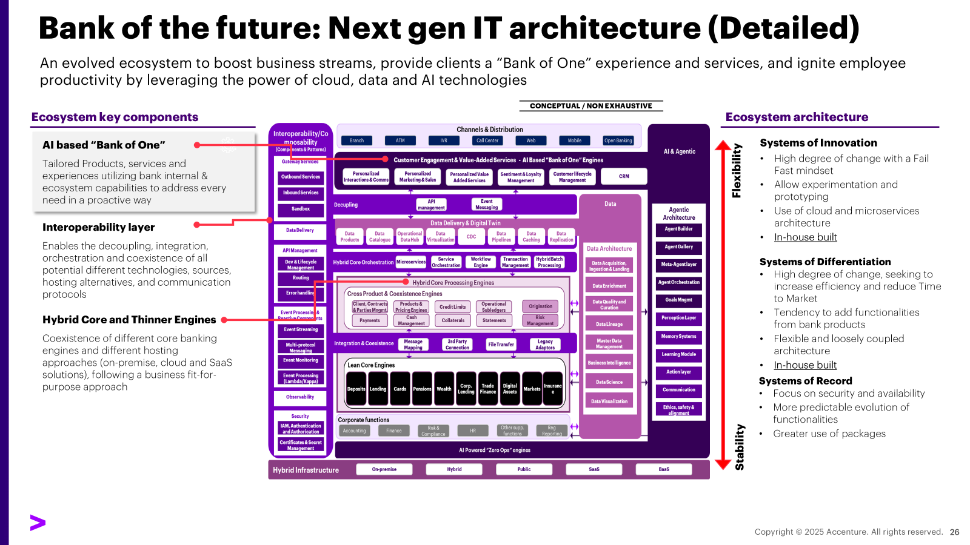
Bank of the future | Next gen Banking Architecture
Tech. Architecture Modernization
Our view of the future banking IT architecture is based on three main components:
AI based ”Bank of one" engine where the best choice of products, services and experiences are created individually to perfectly match client context, using bank's own and market ecosystem capabilities in a proactive way at the point and moment of need through every possible interaction mean. This will require analytic capabilities all across the board and a solid individually oriented data hub.
Interoperability abstraction engine that ensures the decoupling, technical integration, orchestration and coexistence of all potential different technologies from different sources, hosting alternatives and communication protocols, in a seamless way.
Hybrid-Core applications and processors, legacy and next-gen, on-premise, cloud and SaaS working together under a business fit-for-purpose approach, feeding and being fed from the interoperability layer with the required functional and technical interoperability/coexistence capabilities
1
2
3
Detailed View

Slide 3
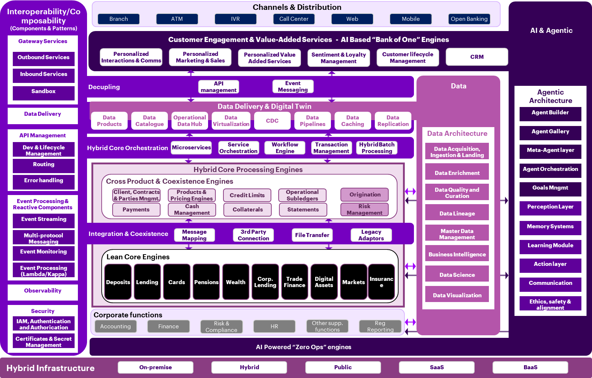
Bank of the future | Next gen IT architecture (Detailed)
An evolved ecosystem to boost business streams, provide clients a “Bank of One” experience and services, and ignite employee productivity by leveraging the power of cloud, data and AI technologies
Ecosystem key components
CONCEPTUAL / NON EXHAUSTIVE
Ecosystem architecture
AI based “Bank of One”
Tailored Products, services and experiences utilizing bank internal & ecosystem capabilities to address every need in a proactive way
Systems of Innovation
High degree of change with a Fail Fast mindset
Allow experimentation and prototyping
Use of cloud and microservices architecture
In-house built
Flexibility
Interoperability layer
Enables the decoupling, integration, orchestration and coexistence of all potential different technologies, sources, hosting alternatives, and communication protocols
Systems of Differentiation
High degree of change, seeking to increase efficiency and reduce Time to Market
Tendency to add functionalities from bank products
Flexible and loosely coupled architecture
In-house built
Hybrid Core and Thinner Engines
Coexistence of different core banking engines and different hosting approaches (on-premise, cloud and SaaS solutions), following a business fit-for-purpose approach
Systems of Record
Focus on security and availability
More predictable evolution of functionalities
Greater use of packages
Stability

Slide 4

Legacy modernization and bank of the future
Tech. Architecture Modernization - Coexistence (Cross-product engines & transactional integrity)
A comprehensive end-to-end architectural view enables seamless integration across systems, reduces complexity, and ensures a cohesive modernization strategy that supports future growth.
Logical Coexistence
Technical Coexistence (Key patterns)
Coexistence services will allow to gradually evolve the architecture pivoting at any time. Coexistence will be structural enablinga ecosystem oriented and composable business approach.
Technical coexistence is a set of enablers that support the decoupling and integration services as well as coexistence services
Party Master
Contract Management
Product Catalogue
Statements
Reports
Conductor (Saga)
Confidentiality
Caching
Reference Data
Unique repository for customer information systems that will allow sharing of customer information across the whole entity. Can provide segmented views based on different profiles.
Maintaining and updating contract information, monitoring contract activity, and handling contract-related requests and inquiries.
Involves maintaining and managing product components and configuration proactively and driven by insightful data-driven analysis.
Includes activities related to issue of regular customer/ account statements in both electronic and physical formats and notifications and ad-hoc/on-event notifications.
Includes the capability to merge information across different systems and provide a unified view across operational, accounting, informational and regulatory reporting.
Manages long-running transactions that span multiple services. It enables the coordination and orchestration of these transactions to ensure data consistency and reliability.
Verifies that a user, even if authorized to perform an operation on a person or contract, has the required profile to access the information based on the level of confidentiality that the entity has established for that person or contract.
Process of storing frequently accessed data in a temporary storage location (cache) to improve performance by reducing the need to repeatedly fetch the data from its original source.
Manages the relation between values admitted for given parameters.
Depending on a code, it retrieves a combination of values.
Limits Management
Currency
Pricing (Interest & Fee)
Pooling & Sweeping
Accounting Engine
Operation ID
Error Management
Data Modeling
Observability
Process of handling authorizations and counterparties credit lines limits to monitor counterparty/credit risk management.
Limits are managed across credit and transactional activities.
Refers to an entity's ability to facilitate the conversion of one currency into another, enabling international transactions and trading. It enables the exchange of currencies at prevailing market rates.
Management of pricing strategy by calculating cost, applying different models, and evaluating customer and competitor behavior.
Applying the appropriate interest and fee rates based on personalized offers.
Cash management strategy that involves consolidating a company’s multiple cash accounts into a single account or pool to optimize overall cash position, improve cashflow management, and benefit from interest income or cost savings.
Generation, enrichment and reporting of accounting events. Includes the use of Open Banking/PSD2 process to aggregate financial data from movements of bank accounts and feed credit risk engine with more accurate data.
Unique ID that must be generated on the request to be propagated along the different layers.
Allows traceability of the entire operation.
Enables management of component errors (functional or technical) and those within the process/API choreography. Is based on error codes to be interpreted by the choreography/ orchestration layer.
Central repository for registering and maintaining data related across different business concepts. Single point of contact to record existing information, how it is being generated and data dependencies.
Ensure observability from two different angles:
1.- Mapping of all tech components supporting each one of the different business services
2.- Dynamic and live traceability of all the different flows among all tech conpoments involved.

Slide 5
02.
Interoperability Framework
Copyright © 2025 Accenture. All rights reserved.
5

Slide 6

Interoperable architecture principles
Interoperable architecture is RED (reactive, real-time, event-driven and decoupled)
Reactive: A responsive architecture in case of failure, allowing to scale to any size and manage variable volumes. Reactive architecture enables resiliency and scalability across any domain.
Real-time: Data and messages are in constant choreography, flowing across the system as streams. Interoperable architecture ensures data is delivered real-time allowing to get rid of current systems of engagement data limitations.
Event-driven: All messages tend to be managed via events, data services and functions (which are part of the different domains). React to subscribed events and generate or push their own events isolated from the rest.
Decoupled: Components of the system are autonomous, modular, independently deployable, and choreographed. Decoupling boosts speed-to-market, breaking application interdependencies. This allows for greater flexibility and scalability in adapting to changing business requirements. Appropriate fragmentation of services
Interoperable Architecture
Decoupling
Integration
Choreography / Orchestration
Core Business Services (Backbone)
Co-existence
Microservices
“Interoperability will allow existing platforms to evolve under a cross common approach, while enabling coexistence with legacy systems and allowing the transformation of business and technology models”

Slide 7
Interoperable architecture
Interoperable Architecture
Decoupling: Reusability and modularity are main principles for a composite architecture. This decoupling layer will support different levels of abstraction allowing to expose information using data language that can be understood across the ecosystem of applications that are available either in the upstream/downstream systems
Abstraction layer that allows components / artifacts to be reusable and includes a strong control, security and monitoring layer
Decoupling
Integration
Core Business Services (Backbone)
Choreography&Orch
Coexistence
Microservices
Interoperable Architecture
Decoupling
Integration: Allowing to integrate different technologies and different applications irrespective of target and source technologies. It is also in charge of security and allows to transmit data in a confidential and security manner.
Allows to aggregate information, stream data ingestion synchronize information across applications
Integration
Core Business Services (Backbone)
Choreography&Orch
Coexistence
Microservices
Interoperable Architecture
Decoupling
Choreography / orchestration: Process of coordinating services, resources and domains to streamline end-to-end IT and business activities. Choreography coordinates synchronous and asynchronous services using queues or events via specific HUBs or brokers (API’s and Events). This orchestration facade allows to easily configure and monitor services, bundling different granular services into end-to-end functions. Such function can either be business function (i.e. open an account, perform a transfer, …) or technical (i.e. error handling and rollback/reversal capabilities)
Integration
Core Business Services (Backbone)
Choreography&Orch
Coexistence
Microservices

Slide 8
Interoperable architecture
Interoperable Architecture
Coexistence: Main enabler of the interoperability required when modernizing old legacy cores. This facade allows old applications to be interoperable with brand new business domains or applications.
Core Banking modernization programs take long and are subject to changes, flexibility will come via the implementation of a coexistence layer that will facilitate the interoperations between the new and the old platforms (i.e. maintaining old vs new customer IDs or account numbers or even transactions, …)
Decoupling
Integration
Core Business Services (Backbone)
Choreography&Orch
Coexistence
Microservices
Microservices: Synchronous and asynchronous services which embed business logic and technical accelerators required to support coexistence process and that will hold granular business services that are neither provided by the existing legacy systems nor by any of the platforms selected.
This layer can be understood as an extensibility layer to allow o complement any type of missing functions needed to allow the interoperation of the various ecosystem applications.
Interoperable Architecture
Decoupling
Integration
Core Business Services (Backbone)
Choreography&Orch
Coexistence
Core Business Services: Main enabler of the interoperability required when modernizing old legacy cores. This facade allows old applications to be interoperable with brand new business domains or applications.
Core Banking modernization programs take long and are subject to changes, flexibility will come via the implementation of a coexistence layer that will facilitate the interoperations between the new and the old platforms (i.e. maintaining old vs new customer IDs or account numbers or even transactions, …)
Microservices

Slide 9
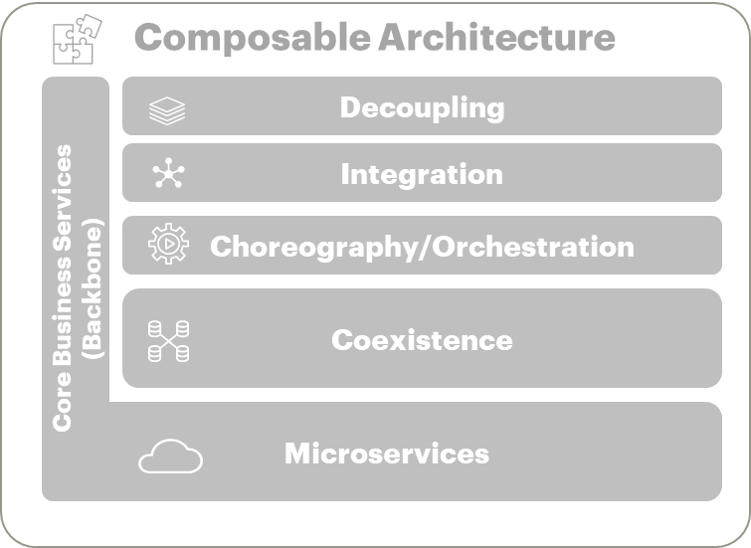
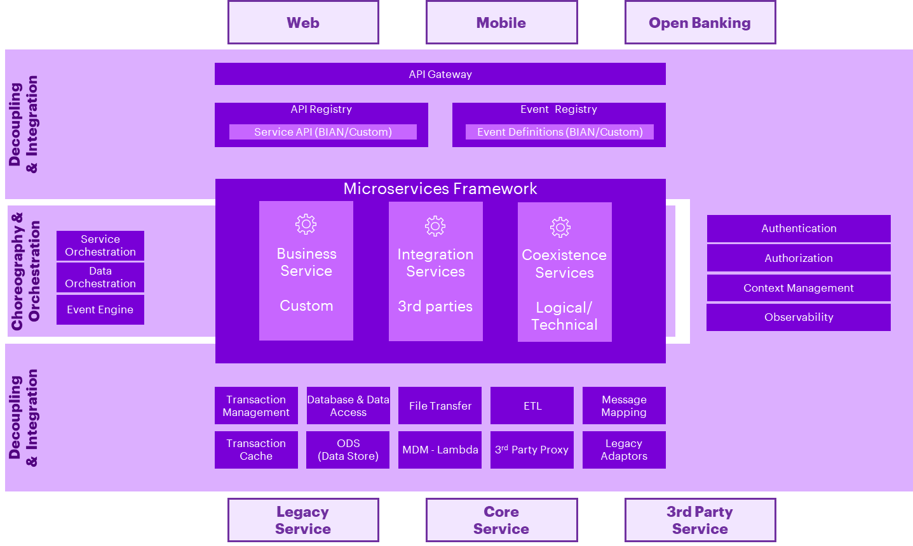
Interoperable Architecture is more than an integration architecture
Much more than integration.
Interoperable architecture is made across different layers
Covers customer engagement through integration and ending with business services and orchestration with different processors (enabling coexistence) and legacy systems
Disaggregates old applications into capabilities and domains making them independent of each other, simplifying the logic
Maximizes open source to decouple from vendor lock-in
1
2
Micro frontends that can be integrated into standalone feature composition or part of a single or multi-channel process
Integration and decoupling to isolate complexity and enable consistency and compatibility across different platforms while securing data flows
Choreography or event manager allowing each component to independently support a business operation depending on a central orchestrator
Microservices aligned to business capabilities providing with granular features under standard data structures following BIAN standards.
Coexistence and integration capabilities enabling to cross common services and function
2
4
5
3
2

Slide 10
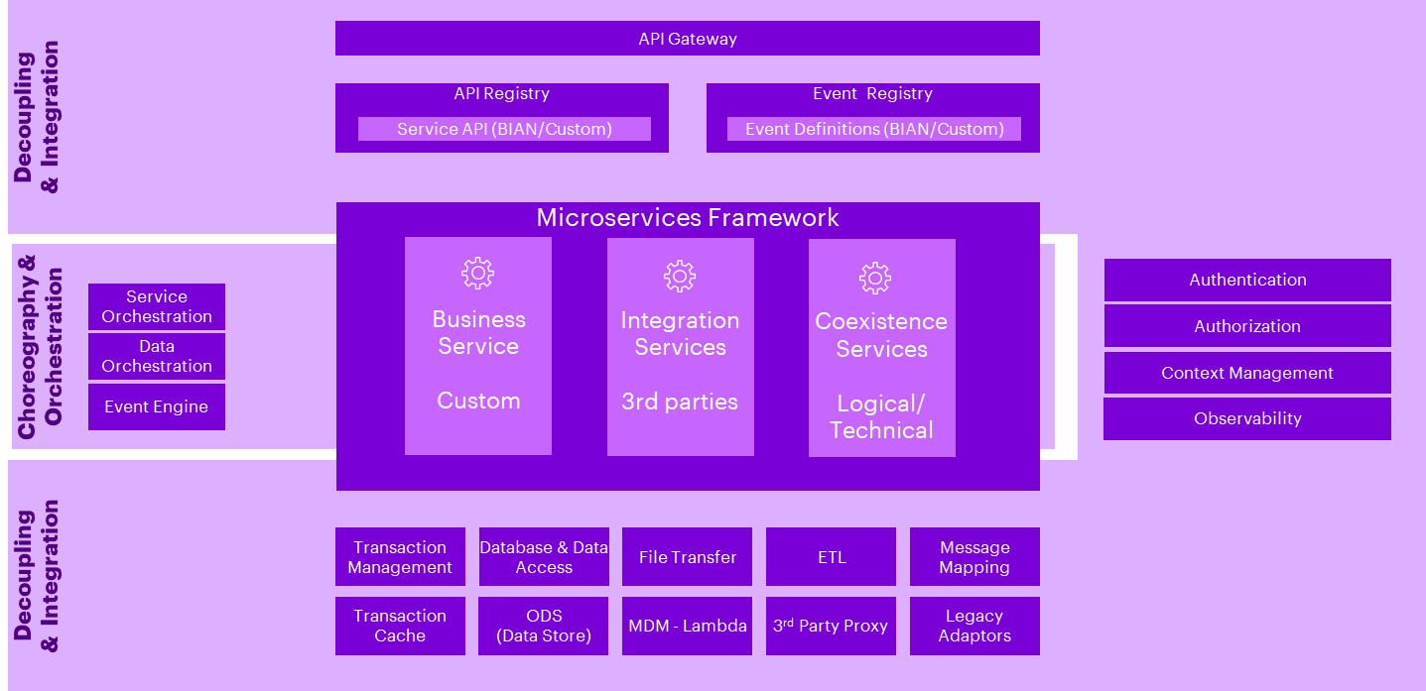
Legacy modernization and bank of the future
Tech. Architecture Modernization
Decoupling from legacy systems and enabled integration are key to interoperability:
Architecture shall be loosely coupled to support the mapping of different business capabilities to business processes
Decoupling principle enables isolation of integrations across major components
Online integrations are managed across two types of integrations: REST API’s and Events which are published in the different registries enabled by the architecture. Any online integration shall be done via the above-mentioned mechanisms
Decoupling with consuming applications and systems is achieved across different components, via gateway and registries for API Rest and Events. Decoupling with legacy systems is achieved through instrumental proxy components leveraging the integration mechanisms prescribed by the interoperable architecture
A
Event-based integrations as preferred option to achieve real-time, stateless event driven integrations on an interoperable architecture. Events are identified and listed in the event registry for subscription by other components:
One-off events generated by services built in the interoperable architecture (stream-in), or generated by a 3rd party (stream-out)
Scheduled Events which will be generated by the composite services with the support of a specific scheduler mechanism
B
C
D
API REST registry, API services are handled by a single registry through an inventory of all APIs registered in the architecture allowing to provide better control. APIs can use synchronous or asynchronous patterns
E
Identity and Access Management: focused on managing user identities and controlling access to resources. It includes practices such as strong authentication, user provisioning, and role-based access control, including identity and access monitoring to inspect user identities and prevent unauthorized access as well as user activity monitoring (UAM) analyzing user behaviors to identify potential security risks
Integration layer should be flexible to manage any type of messaging and formats including ETL mechanisms, file sharing and data persistence platforms… for interoperation with legacies or 3rd party applications

Slide 11
03.
Interoperability Capability Model
Copyright © 2025 Accenture. All rights reserved.
11

Slide 12
***Confidential - For Company Internal Use Only***
Interoperability Architecture | Kernel & Platform vs Domain
In one line Kernel & Platform is the building. Domain capabilities are the offices you fit out inside it.
Kernel & Platform
The building — always on, shared by all
Domain Capabilities
The shops — named work, added when needed
K
Security · Observability · Infrastructure · API Management · Gateway Services
Orchestration · Events · Transactions · Data Delivery · Omnichannel · Common Business Services
Like a shopping mall’s structure, power, plumbing, fire alarms, CCTV and security desk: built before any shop opens. Every shop uses them, no shop provides its own — and without them nothing can legally open.
These are the shops. Each does work you can name and value: “coordinate six services into one loan disbursement,” “keep a mortgage balance consistent across mainframe and the new core,” “resume onboarding on mobile after starting in branch.”
▸ Nobody asks for it directly. No sponsor requests “observability” — they request a mortgage journey that can’t go live without it.
▸ Built once, centrally, up front. A fixed cost the platform team owns, not something each product team re-does.
▸ It’s binary. You either have a certified security & monitoring foundation, or you don’t. There’s no half a fire alarm.
→ Build it once. It’s the foundation everything else stands on.
▸ A business case pulls each one in. You build event streaming when a journey needs it — not on principle.
▸ Built incrementally & partially. Saga-based consistency for payments this year, lending next year. That’s normal and correct.
▸ Optional in sequence, not in substance. Some banks never need complex event processing; almost none can skip transaction consistency.
→ Add each when the business case arrives, and grow it over time.

Slide 13
***Confidential - For Company Internal Use Only***
Interoperability Architecture | Capability Map Level 0
Security
Observability
Gateway Services
Event Processing
& Reactive Components
Infrastructure
K
K
K
K
API Management
K
Omnichannel & Caching Components
Distributed Transactions
Common Business Services
Data Delivery
K
Kernel & Platform Components
Domain Components

Slide 14
***Confidential - For Company Internal Use Only***
Interoperability Architecture | Level 0 Capabilities — Description & Purpose
Kernel & Platform Capabilities (K = Kernel & Platform Components)
API Management
Design, publish, version, secure, meter and retire the bank's synchronous service contracts, plus the developer portal, catalogue and sandbox.
Purpose The primary decoupling instrument: a stable API contract lets channels and cores be re-platformed independently, turning a system call into a banking-capability call.
Gateway Services
Controlled ingress and egress across the trust boundary in three modalities — API, file and event, inbound and outbound — plus Open Banking and partner edges.
Purpose Makes ecosystem participation a configuration exercise, not a project. Inbound API gateways are usually mature; outbound file and event gateways are the common critical-path gap.
Security
End-to-end protection of the interoperability layer: IAM, crypto and HSM, certificate and secret management, audit logging, threat protection, container and streaming security.
Purpose Security is inherited from the platform, not re-coded per service — so the attack surface and remediation cost do not grow faster than the functionality.
Observability
Evidence across the estate: log aggregation, distributed tracing, API and health monitoring, alerts, metrics, and technical and business dashboards.
Purpose Restores the end-to-end truth of a transaction no single system now holds, and turns telemetry into a business-service-level risk and performance view.
K
K
K
K
Operations
Cross-cutting runtime primitives: folio operations, feature flags, distributed UUID/correlation services, and the admin consoles for the layer.
Purpose Small capability, disproportionate leverage — feature flags and distributed UUIDs make incremental, reversible migration possible: route a % of traffic, trace it, roll back without a release.
Infrastructure (Tech Stack)
The runtime foundation: microservices framework, container platform and service mesh, discovery, caching, config automation, deployment and resilience (incl. chaos engineering).
Purpose Determines the marginal cost of adding a component. A curated, governed stack delivers deployment agility and elastic scale, keeping thousands of services governable by a small team.
K
K
Domain Capabilities
Service Orchestration
Composition of fine-grained services into complex business services across heterogeneous platforms, sync or async — integration framework, orchestrator, legacy adaptors, context mgmt.
Purpose Makes best-of-breed coexistence executable: one service spans next-gen core, SaaS processor and mainframe invisibly. Usually the largest productivity gain and precondition to retire legacy middleware.
Process Orchestration
Longer-running human-and-system flows — workflow, approvals, task lists, state and rule management — on lightweight workflow engines rather than heavyweight enterprise BPM.
Purpose Separates the millisecond technical flow from the multi-day business flow, making journeys, four-eyes controls and exception handling portable across products and channels.
Distributed Transactions
Atomicity and consistency across services and data stores: 2PC where possible, Saga/compensation where not; coordinator, outbox/inbox, store & forward, online admin.
Purpose Non-negotiable for banking. Provides the framework and tooling to retry, reverse and report; Store & Forward adds continuity when a host is down and for future-dated actions.
Event Processing & Reactive Components
The asynchronous backbone: event messaging and streaming, event registry and canonical events, guaranteed delivery, event mesh, event sourcing, CEP, CQRS.
Purpose Lets systems interoperate without knowing each other — the deepest decoupling. Highest-reuse investment; CQRS/CDC is the cheapest early lever to offload the mainframe with no core change.
Omnichannel & Caching Components
Omnichannel data management and access services, transaction cache, session replication and inter-domain session state, caching and CDN components.
Purpose Holds cross-channel context so a journey resumes in another channel and is served at latency the core cannot meet — reducing abandonment and adding continuity when a backend is down.
Data Delivery
Data catalogue & modelling (catalogue, metadata, lineage, quality, governance) plus data pipelines & delivery (batch/stream, CDC, virtualization, ODS, multi-speed).
Purpose Provides a standardized, real-time, multi-core aggregated view so consumers use “the bank's data”, not “the core's data” — removing direct application access and one-core lock-in.
Common Business Services
Standardized, reusable horizontal business services — customer data, product catalogue, fees/pricing, limits, FX, accounting, documents, payments, risk scoring, approvals.
Purpose Turns interoperability into structural coexistence: lifting cross-product functions into shared services de-risks core replacement and stops re-implementing the same logic per product.

Slide 15

***Confidential - For Company Internal Use Only***
Interoperability Architecture | Capability Map Level 0
Security
Observability
Gateway Services
Event Processing
& Reactive Components
Infrastructure
K
K
K
K
Transact internal
API Management
K
Omnichannel & Caching Components
Apolo Origination
Distributed Transactions
Loan pay off Pisa-> Trasnact
Common Business Services
Data Delivery
Customer Data Syncronization
Potential Use Cases
K
Kernel & Platform Components

Slide 16

***Confidential - For Company Internal Use Only***
Interoperability Architecture | Capability Map Level 1
Security
Observability
Gateway Services
Event Processing
& Reactive Components
Infrastructure
K
K
K
K
Outbound
Identity & Access Mgmt
Monitoring
Switching
API Gateway
File Gateway
EventHub Gateway
Sandbox
Operational Log Services
Inbound
Access Token / SSO
Security Token Service (STS)
API Gateway
File Gateway
EventHub Gateway
Event Messaging
Infra Resilience
Authentication Services
Health Monitoring
Open Banking Edge
Filter Edge
Event Registry
Business Dashboards
Tech Stack
Session Services
API Management
Event Streaming
Caching
Tech Dashboards
K
Authorization Services
Routing
API versioning
Error Handling
Lifecycle Mgmt
API Manager
Developer Portal
Multi-protocol
Messaging
Crypto Services
Alerts
CEP Processing
Microservices Framework
Signature Ops
Metrics & Analytics
Omnichannel & Caching Components
E2E Tracing
Omnichannel Data Mgmt
Process Orchestration
Approvals
Event Monitoring
Platform Config. Automation
Encryption Ops
E2E Encryption
Reporting
Distributed Transactions
Language Runtimes
Service Orchestration
Transaction Mgmt
Image Streaming
Certificate &
Secret Mgmt
Service Orchestrator
Online Admin
Automated Testing
Certificate Mgmt
Legacy Adaptors
Store & Forward
Deployment Strategies
Secret Mgmt
Event Processing
HSM
Common Business Services
Base Libraries
Operations
Scope dependent
Vulnerability and Threat Mgmt (VTM)
Feature Flag
Folio Operations
Data Delivery
Data catalog & modeling
Data Pipelines & Delivery
Key Patterns
Distributed UUID Services
Data Catalog
Metadata management
Stream Data Integration
Data Replication
Knowledge Graph & Enrichment
Batch Data Integration
Data Virtualization
Legend
Capability
K
Kernel & Platform Components

Slide 17
***Confidential - For Company Internal Use Only***
Interoperability Architecture | Security
KERNEL & PLATFORM | 6 SUB-CAPABILITIES
Sub-capability | Description | Purpose | Solutions in Coppel
1.1 Identity & Access Management | Authentication, authorisation, token and session services for customers, employees, partners and machine identities consuming the interoperability layer. | Provides the single authoritative answer to who is calling and what they may do, so entitlement logic is removed from business services. | OAuth 2.0 via Apigee OKTA Azure AD / Microsoft Entra ID Token Party Identity Incode identity/KYC HashiCorp Vault for credential support
1.2 Crypto Services | Shared cryptographic operations - signing, encryption, end-to-end payload protection - delivered as callable services backed by hardware security modules and managed key stores. | Concentrates the highest-assurance controls in one certified component, so cryptography is consumed rather than reimplemented. | AES-256 encryption TLS/SSL HSM key management Oracle TDE Istio mTLS Incode/NOM-151 signature for onboarding contracts
1.3 Certificate & Secret Management | Issuance, distribution, rotation, revocation and audit of certificates and application secrets consumed by services, gateways and pipelines. | Automates the operational hygiene that fails most often at scale; expired certificates and hard-coded secrets are among the most frequent causes of outage and audit finding in distributed estates. | HashiCorp Vault AWS Secrets Manager Kubernetes Secrets SSL certificate management HSM for critical key operations
1.4 Threat Protection | Detection and mitigation of hostile traffic and runtime attack techniques at the perimeter, at the API layer and inside the container and streaming platforms. | Protects the widened attack surface that decoupling necessarily creates, at the layers where exposure is greatest. | Imperva WAF Cloud Armor AWS Shield Apigee OAuth/rate limiting Istio service mesh Exabeam SIEM HashiCorp Vault and hardening controls
1.5 Vulnerability & Threat Management (VTM) | Continuous identification, prioritisation and remediation of vulnerabilities across libraries, images, platforms and interfaces, including adversarial testing. | Directly addresses the cost and time spent managing vulnerabilities across a large microservice estate - the stated objective behind curating base libraries and eliminating unnecessary dependencies. | DevSecOps security gates SAST/DAST practices SonarQube and OWASP ZAP referenced for pipeline security hardening validation vulnerability scans
1.6 Security Observability & Response | Security-specific telemetry, correlation, alerting, dashboards and automated response built on the shared observability backbone. | Closes the most frequently observed gap in interoperability programmes: security telemetry exists in fragments and there is no automated response capability. | Exabeam SIEM for threat detection DataDog for security/operational dashboards CloudTrail/CloudWatch where AWS services are used incident escalation via Ops/Security
Capability Assessment
Target
Priority
High
GAP
Med
Discard
Low

Slide 18
***Confidential - For Company Internal Use Only***
Interoperability Architecture | Observability
K
KERNEL & PLATFORM | 5 SUB-CAPABILITIES
Sub-capability | Description | Purpose | Solutions in Coppel
2.1 Monitoring | Continuous collection and evaluation of the health and availability of platform components, interfaces and dependencies, with threshold and anomaly-based alerting. | Detects degradation before customers do, which matters more in a composed estate where one weak dependency degrades many journeys. | DataDog monitoring, dashboards and alerting CloudWatch/CloudTrail for AWS components Apigee analytics platform health checks across Apolo, Transact and SmartVista
2.2 Logging | Structured collection, normalisation, indexing, retention and rotation of technical, operational and audit logs from every component in the interoperability layer. | Provides the forensic and audit substrate for a distributed estate where no single application log tells the whole story. | DataDog logs/monitors Exabeam SIEM AWS CloudTrail/CloudWatch audit trails from Apigee, Transact, SmartVista and regulatory/reporting flows
2.3 Tracing | Propagation and reconstruction of the full execution path of a request across services, platforms, protocols and asynchronous hops, based on a consistently propagated correlation identifier. | The single most important observability capability in an interoperable architecture: it is what makes a distributed transaction explainable end to end, across legacy and next-gen alike. | DataDog APM/tracing is planned as advanced observability Istio supports service-level telemetry. Correlation identity service is not explicitly named
2.4 Metrics, Analytics & Reporting | Derivation, storage and analysis of technical and business metrics from telemetry, including automated correlation and machine-learning-assisted detection, and periodic reporting. | Turns raw telemetry into the management information used to evidence the interoperability business case and to steer platform investment. | DataDog KPIs Apigee analytics Google Analytics for digital behaviour Data Warehouse/DataStage for reporting feeds executive PMO dashboards
2.5 Dashboards | Role-oriented visualisation of platform and business telemetry for engineering, operations, security, business and executive audiences. | Converts observability from an engineering tool into a shared management instrument, including the business-service-level IT risk view. | DataDog technical dashboards PMO / executive dashboards regulatory and business dashboards via Data Warehouse, Bajaware/Risklogic and project reporting
Capability Assessment
Target
Priority
High
GAP
Med
Discard
Low

Slide 19
***Confidential - For Company Internal Use Only***
Interoperability Architecture | Operations
KERNEL & PLATFORM | 4 SUB-CAPABILITIES
Sub-capability | Description | Purpose | Solutions in Coppel
3.1 Folio Operations | Grouping of the technical operations that make up a single business transaction under one business reference, with the ability to retrieve, report on and act upon that group as a unit. | Restores the business-level unit of work that a monolithic core provided implicitly, which is what keeps reversal, enquiry and reporting meaningful after decomposition. | No dedicated folio service is evidenced related identifiers/reporting are in PMO dashboards, Transact/SmartVista operational records and Data Warehouse reporting
3.2 Feature Flag Management | Runtime configuration of feature availability, allowing behaviour to be enabled, targeted or withdrawn per consumer, entity, channel or traffic share without redeployment. | The primary control lever for de-risked cut-over: it converts a migration event into a gradual, observable and reversible transition. | Feature flags are referenced as a channel innovation practice, but no tool is named deployment rollback uses DevSecOps pipelines/Helm and platform rollback controls
3.3 Distributed UUID & Correlation Services | Generation of collision-free unique identifiers across distributed components and consistent propagation of correlation identifiers through synchronous and asynchronous paths. | The single technical dependency underneath end-to-end traceability, distributed audit and idempotency control; without it, none of those capabilities can function. | No standalone UUID/correlation service is evidenced likely handled by Apigee/MuleSoft/Istio/DataDog patterns and application-level identifiers
3.4 Platform Administration Consoles | Administrative interfaces for the interoperability layer: service registry administration, runtime configuration, and operational control of shared components. | Gives named owners a governed way to change platform behaviour, which is what allows the layer to be operated by an operations function rather than by its builders. | Apigee admin/policies SmartVista Back Office Transact administration/Product Catalog DataDog dashboards Terraform/GitHub configuration management
Capability Assessment
Target
Priority
High
GAP
Med
Discard
Low

Slide 20
***Confidential - For Company Internal Use Only***
Interoperability Architecture | Gateway Services
K
KERNEL & PLATFORM | 4 SUB-CAPABILITIES
Sub-capability | Description | Purpose | Solutions in Coppel
4.1 Inbound Gateway Services | Managed entry points for traffic originating outside the bank's trust boundary, across API, file and event channels, including identity assertion exchange at the edge. | Gives the bank one governed front door per modality instead of a proliferation of bilateral connections with inconsistent controls. | Apigee inbound/outbound API gateway MuleSoft/WebMethods integration Amazon API Gateway via Modyo Connect EKS/Istio service edge
4.2 Outbound Gateway Services | Managed exit points for bank-originated traffic to downstream counterparties, across API, file and event channels, including transaction switching to schemes and processors. | Externalises counterparty-specific connectivity and credentials from application code, so a provider can be replaced without touching business services. | Apigee inbound/outbound API gateway MuleSoft/WebMethods integration Amazon API Gateway via Modyo Connect EKS/Istio service edge
4.3 Ecosystem & Open Banking Edge | Specialised external-facing edges for regulated open banking traffic, partner onboarding and controlled experimentation, including filtering edges and marketplace exposure. | Where the interoperability layer becomes a business channel: it turns internal capabilities into consumable, contracted products for third parties. | No specific Open Banking marketplace/partner sandbox product is evidenced adjacent capabilities use Apigee, API Gateway, BIAN APIs and sandbox/UAT environments
4.4 Perimeter Zoning & Connectivity | Network segmentation, DMZ exposure model, transport security termination and connectivity management underpinning all gateway modalities. | Establishes the trust topology within which every other gateway capability operates; without it, decoupling increases exposure rather than containing it. | Imperva WAF / Cloud Armor AWS Shield Zscaler TLS termination VPN/Direct Connect Tetration rules AWS/GCP/on-prem network zoning
Capability Assessment

Slide 21
***Confidential - For Company Internal Use Only***
Interoperability Architecture | API Management
K
KERNEL & PLATFORM | 4 SUB-CAPABILITIES
Sub-capability | Description | Purpose | Solutions in Coppel
5.1 API Gateway & Runtime Mediation | Runtime plane that terminates, validates, mediates and routes API traffic between consumers and providers, applying policy at the point of invocation rather than inside application code. | Enforces the contract at runtime, so decoupling is guaranteed by the platform instead of by developer discipline. | Apigee API Gateway/API Management MuleSoft integration/orchestration WebMethods BPM/BRM BIAN-aligned APIs Transact OFS/IRIS REST APIs
5.2 API Lifecycle Management | Control plane that governs an API from design and contract definition through publication, versioning, change notification and eventual retirement. | Turns interfaces into managed enterprise assets with a controlled change path, which is the precondition for reuse across entities and countries. | BIAN API standards Apigee API lifecycle/governance OpenAPI/Swagger-style API documentation for OfiWeb/Canales API change controlled by architecture governance
5.3 API Manager (Platform Administration) | Administration, policy configuration, operation and commercial instrumentation of the API management platform itself, across on-premise, cloud or hybrid topologies. | Keeps policy centrally administered and consistently applied, so security and traffic rules do not fragment per API team. | Apigee platform administration and policies DataDog/API monitoring DevSecOps pipelines GCP-hosted Apigee with AWS/on-prem providers
5.4 Developer Portal & Catalogue | Self-service surface where internal and external developers discover, evaluate, register for and support themselves on published interfaces. | Reuse only happens if capabilities are findable. The portal converts a technical inventory into a consumable product catalogue. | API catalogue/governance for Apificación de Canales and OfiWeb Apigee as API management plane. No standalone developer portal tool is explicitly evidenced
Capability Assessment
Target
Priority
High
GAP
Med
Discard
Low

Slide 22
***Confidential - For Company Internal Use Only***
Interoperability Architecture | Omnichannel & Caching Components
DOMAIN CAPABILITY | 4 SUB-CAPABILITIES
Sub-capability | Description | Purpose | Solutions in Coppel
6.1 Omnichannel Data Management | Temporary and working storage of in-progress interaction data, with access services that let any channel read and continue a journey started elsewhere. | Makes the journey, rather than the channel, the unit of design - the practical foundation of a genuine omnichannel proposition. | App BanCoppel, Web/OFI, Sucursal, ATM, CAT and Teller Multi Core Apificación de Canales Golden Record/Party-CIF Apolo onboarding
6.2 Caching Components | Distributed and in-memory caching of reference and frequently accessed data, with invalidation and refresh control, plus acceleration of static content delivery. | Decouples channel responsiveness from backend capacity, which both protects legacy systems and improves customer experience at the same time. | App BanCoppel/Web/Branch/ATM/CAT/Teller Apolo/Modyo Apificación de Canales Redis CloudFront Golden Record
6.3 Session Management & Replication | Caching and replication of session state across instances, availability zones and domains so that channel sessions survive failure and cross domain boundaries. | Provides continuity of authenticated interaction, without which elastic scaling and rolling deployment would be visible to customers as dropped sessions. | Redis and Modyo/Apolo session support are evidenced no separate enterprise session-replication product is named
6.4 Transaction Cache & Low-Latency Read Serving | Caching of in-flight transaction data and of frequently requested read views, served to channels independently of the system of record. | The practical mechanism for offloading read traffic from constrained cores - typically the fastest available lever on MIPS and response time, requiring no core change. | Redis in Apolo stack Modyo/AWS CloudFront for static content YugabyteDB for operational data. Cache invalidation tool not specifically named
Capability Assessment
Target
Priority
High
GAP
Med
Discard
Low

Slide 23
***Confidential - For Company Internal Use Only***
Interoperability Architecture | Distributed Trxs – Trxs Management
DOMAIN CAPABILITY | 4 SUB-CAPABILITIES
Sub-capability | Description | Purpose | Solutions in Coppel
7.1 Transaction Management | Coordination of multi-participant business operations, tracking the success or failure of each step and driving either completion or compensating reversal, with durable recording of state and history. | Guarantees that a business transaction spanning legacy, next-gen and third-party systems either completes or is fully unwound, with evidence. | Temenos Transact FT/Payments/GL BPC SmartVista/SVIP Hub de Pagos Kafka/Confluent Amazon MQ/Kinesis Interfaces Temporales
7.2 Transaction Operations & Control | Operator-facing tooling to observe, intervene in and report on complex transactions, including retry, cancel and reverse actions and technical plus operational event monitoring. | Makes distributed consistency operable by named teams; without it, correctness depends on engineering escalation for every anomaly. | Temenos Transact FT/Payments/GL BPC SmartVista/SVIP Hub de Pagos Kafka/Confluent Amazon MQ/Kinesis Interfaces Temporales
7.3 Store & Forward | Persistence and controlled later execution of requests that cannot complete now - because a hosting system is unavailable, or because the user scheduled the action for a future date - comprising request manager, registry, processor, router and console. | Delivers service continuity when part of the estate is down and, reusing the same mechanism, supports future-dated instructions such as scheduled payments. It is a primary reason customers do not experience legacy availability limits directly. | Amazon MQ/Kinesis and Kafka/Confluent for reliable exchange Interfaces Temporales with retry/fallback to PISA batch/COB where synchronous processing is not possible
7.4 Transactional Service Administration (Online Admin) | Runtime administration of transactional behaviour: which services are atomic, which are store-and-forward eligible, which require approvals, and the operational overrides available to control functions. | Makes transactional characteristics declarative and centrally governed, so behaviour can be adjusted operationally without code change during migration windows. | SmartVista administration Transact Product Catalog/AA Framework Apigee policy controls operational overrides via platform admin consoles
Capability Assessment
Target
Priority
High
GAP
Med
Discard
Low

Slide 24
***Confidential - For Company Internal Use Only***
Interoperability Architecture | Distributed Trns - Service Orchestration
DOMAIN CAPABILITY | DOMAIN 6.0 | 4 SUB-CAPABILITIES
Sub-capability | Description | Purpose | Solutions in Coppel
8.1 Service Orchestrator | The engine that decomposes a complex service into an ordered or parallel set of fine-grained service invocations and manages their execution, results and exceptions. | Concentrates cross-system business logic in one governed, visible place instead of dispersing it across channels and cores. | MuleSoft orchestration Software AG WebMethods BPM/BRM Apigee invocation management Modyo Connect state-machine style flow orchestration DataDog diagnostics
8.2 Integration & Mediation Framework | Transformation, mapping and protocol-bridging services that reconcile differing data contracts, formats and communication mechanisms between participating platforms. | Absorbs heterogeneity so that adding a new processor or provider is an adaptor exercise rather than a change to the consuming estate. | MuleSoft WebMethods Apigee Modyo Connect BIAN services Interfaces Temporales/Strangler Fig Transact OFS/IRIS APIs
8.3 Context Management | Capture, propagation and consistent availability of execution context - identity, channel, entity, locale, correlation, entitlements - across every hop of a composed service. | Without propagated context, distributed audit, entitlement enforcement and tracing all break at the first system boundary. | Golden Record / Party-CIF Transact Product Catalog and AA Framework BRM Apigee/MuleSoft context propagation not a separate registry product in sources
8.4 Legacy Adaptors | Service wrappers and platform-specific adaptors that expose legacy-resident functions as standard APIs and events, bridging from the microservices architecture to mainframe and proprietary platforms. | The workhorse coexistence capability: it makes legacy function consumable by modern journeys without modifying legacy code, which is what allows modernisation to be incremental and reversible. | Interfaces Temporales using Strangler Fig/ByPass PISA/Informix wrappers Apificación OfiWeb Teller Multi Core batch/COB interfaces and decommissioning roadmap
Capability Assessment
Target
Priority
High
GAP
Med
Discard
Low

Slide 25
***Confidential - For Company Internal Use Only***
Interoperability Architecture | Process Orchestration
DOMAIN CAPABILITY | 4 SUB-CAPABILITIES
Sub-capability | Description | Purpose | Solutions in Coppel
9.1 Workflow Services | Definition, versioning and execution of multi-step business processes spanning services, systems and human participants. | Makes process logic explicit and changeable by design authority rather than implicit in code across several systems. | WebMethods BPM Modyo Connect workflow/state-machine Flow Engineering/Jira work management for delivery process flows across Apolo, SmartVista and Transact
9.2 Human Task Management | Creation, assignment, prioritisation and completion of human work items arising from automated processes, including work lists and delegation. | Integrates the human steps that remain in regulated banking processes without pushing them back into channel applications. | Teller Multi Core for assisted branch tasks OnBase/document workflows SIWEB/OFI and branch/call-center work queues. No single BPM task tool is fully evidenced
9.3 Process State & Exception Management | Durable persistence of long-running process state, together with timeout, escalation, retry and exception handling for stalled or failed instances. | Long-running processes fail differently from transactions; explicit state and escalation handling is what prevents silent loss of in-flight business. | WebMethods BPM/BRM and Modyo Connect for process state PMO/RAID escalation fallback/contingency with Interfaces Temporales and PISA
9.4 Process Monitoring & Administration | Operational visibility into in-flight and completed process instances, with administrative intervention and reporting on cycle time and bottlenecks. | Provides the process-level equivalent of distributed tracing and the measurement base for straight-through processing improvement. | DataDog for process/platform monitoring SmartVista Back Office Transact administration PMO dashboards for process performance
Capability Assessment
Target
Priority
High
GAP
Med
Discard
Low

Slide 26
***Confidential - For Company Internal Use Only***
Interoperability Architecture | Common Business Services
DOMAIN CAPABILITY | 6 SUB-CAPABILITIES
Sub-capability | Description | Purpose | Solutions in Coppel
10.1 Customer & Party Services | Shared services providing customer and party master data, relationships and derived attributes to all product domains and channels. | Delivers the single customer view that siloed cores cannot provide, and which every personalisation and bank-of-one ambition presupposes. | Golden Record Temenos Party/CIF Informix/PISA customer master Incode KYC with INE/RENAPO Apolo Onboarding
10.2 Product & Pricing Services | Shared product catalogue, terms, eligibility and fee and pricing calculation services usable by any product processor or channel. | Externalising product definition from the core is what allows new propositions to be launched without a core release, which is the main source of time-to-market gain. | Temenos AA Framework and Product Catalog Interest Engine Charges SmartVista product configuration BRM for pricing/risk rules
10.3 Limits & Risk Services | Shared limit definition, checking and consumption tracking, and risk and credit scoring services callable from any journey. | Places risk controls at the interoperability layer so they apply uniformly regardless of which core or channel originates the transaction. | BRM Merit Crediticio Transact Limits Risklogic Buró/SIC integrations SmartVista fraud/risk controls PAST.DUE collections
10.4 Financial & Accounting Services | Shared accounting event generation and ledger posting, currency conversion, and payment execution services used across product domains. | Preserves financial integrity and one accounting truth while the processing estate is decomposed and partially replaced. | Transact GL/Accounting and PRD.DES.ACCOUNTING Funds Transfer/FT Hub de Pagos/SPEI SmartVista payments PISA ledger during coexistence
10.5 Document & Content Services | Shared document generation, capture, storage, retrieval and retention services supporting customer and regulatory documentation across all products. | Removes per-product document handling, which is one of the most duplicated and least differentiating functions in a banking estate. | OnBase by Hyland for digital files Modyo/Apolo document capture Amazon Pinpoint for WelcomeKit Incode document capture
10.6 Control & Trust Services | Shared control services applied across business journeys: approvals and authorisation hierarchies, and HSM-backed signing and verification of business instructions. | Makes mandatory controls a reusable service invoked by any journey, so control strength does not depend on which product or channel implemented it. | Golden Record Transact Party/CIF/AA/Product Catalog/GL/FT SmartVista OnBase Incode Hub de Pagos BRM Risklogic
Capability Assessment
Target
Priority
High
GAP
Med
Discard
Low

Slide 27
***Confidential - For Company Internal Use Only***
Interoperability Architecture | Data Delivery
DOMAIN CAPABILITY | 4 SUB-CAPABILITIES
Sub-capability | Description | Purpose | Solutions in Coppel
11.1 Data Catalogue & Modelling | Discovery, description, governance and quality management of data assets: catalogue and inventory, metadata (passive, runtime and active), lineage, semantic enrichment, profiling, and access and privacy control. | Data can only be shared safely if it is described and governed; the catalogue is what makes a shared data layer usable by teams that did not create the data. | Data Warehouse DataStage ETL Temenos Data Hub (TDH) Golden Record/Party-CIF Risklogic/Bajaware feeds data governance/privacy controls
11.2 Data Pipelines & Delivery | Movement of data between sources, stores and consumers at the required latency: batch integration, stream integration, replication and virtualised access, from legacy systems, files, lakes, cloud stores and external providers. | The physical plumbing of data decoupling; it is what allows consumers to be served without granting them access to systems of record. | DataStage ETL/ELT Data Warehouse TDH PISA/Informix extraction Oracle/YugabyteDB batch/COB pipelines DataDog monitoring
11.3 Operational Data Store & Unified Data Model | A standardised operational data model holding a real-time, multi-source view of key business entities, consolidated across legacy and next-generation cores and served to consumers as the bank's data layer. | This is the decoupler in data terms. Holding a real-time standardised view consolidated from best-of-breed cores means consumers are not tied to one core and no consumer requires direct mainframe access - the mechanism that most reduces core-modernisation timelines and risk. | Golden Record/Party-CIF Informix/PISA legacy master data Temenos TDH Data Warehouse YugabyteDB/Oracle cross-core consolidation through APIs and DataStage
11.4 Data Consumption Services | The consumption surface over the data layer: data APIs, analytics and reporting feeds, and governed sandbox provisioning for exploratory and model development work. | Ensures the investment in data delivery converts into use; without governed consumption paths, teams revert to direct source access and re-create the coupling that was removed. | DataStage Data Warehouse Temenos Data Hub YugabyteDB Informix/PISA Oracle OnBase Bajaware/Risklogic Golden Record
Capability Assessment
Target
Priority
High
GAP
Med
Discard
Low

Slide 28
***Confidential - For Company Internal Use Only***
Interoperability Architecture | Event Processing & Reactive Components
DOMAIN CAPABILITY | 6 SUB-CAPABILITIES
Sub-capability | Description | Purpose | Solutions in Coppel
12.1 Event Messaging | Publish and subscribe messaging between components, including topic and queue administration and bridging across the multiple messaging technologies typically present in a bank. | Replaces bilateral, synchronous coupling with a shared asynchronous channel, so producers and consumers can change independently. | Kafka/Confluent Amazon MQ Temenos Events Framework Event Processor/Event Router/Event Cleanup MuleSoft for integration messaging
12.2 Event Streaming | High-throughput, durable, replayable streams of events with retention, partitioning and continuous stream processing, including complex event processing over multiple streams. | Provides the real-time data movement capability on which multi-core data aggregation, read offloading and real-time customer context all depend. | Amazon Kinesis Kafka/Confluent Temenos Events Framework with events such as depositCreated/loanOverdue/payrollCredit
12.3 Guaranteed Delivery | Delivery assurance mechanisms - acknowledgement, idempotency control, redelivery and dead-letter management - that make asynchronous integration safe for financial events. | Asynchronous decoupling is only acceptable in banking if delivery is provable; this capability is what makes events usable for accounting and payment flows. | Kafka/Confluent and Amazon MQ patterns no named dead-letter/idempotency product is evidenced delivery assurance should be covered by event platform controls
12.4 Event Registry & Contract Governance | Authoritative catalogue of event definitions and canonical schemas, with versioning, compatibility rules and consumer registration. | The asynchronous equivalent of API lifecycle management; without it, an event backbone degrades into an undocumented mesh of private message formats. | BIAN/API/event governance Confluent/Kafka stack no separate schema registry/catalogue product is explicitly evidenced
12.5 Event Mesh & Routing | Clustered, policy-based routing of events across domains, environments, regions and entities, presenting one logical event fabric over distributed infrastructure. | The mechanism by which a multi-entity, multi-country group shares real-time information without building bilateral links between every pair of platforms. | Kafka/Confluent routing Amazon Kinesis AWS multi-region/DR considerations event routing via Event Router and integration layer
12.6 Event Monitoring | Operational monitoring of the event backbone - throughput, consumer lag, error rates, schema violations - and traceability of individual events for audit and investigation. | Asynchronous flows fail silently by nature; monitoring is what converts them from an operational blind spot into a governed channel. | DataDog event-flow/consumer-lag monitoring target Exabeam/CloudTrail for audit Event Processor/Router telemetry
Capability Assessment
Target
Priority
High
GAP
Med
Discard
Low

Slide 29
***Confidential - For Company Internal Use Only***
Interoperability Architecture | Infrastructure (Tech Stack)
K
KERNEL & PLATFORM | 5 SUB-CAPABILITIES
Sub-capability | Description | Purpose | Solutions in Coppel
13.1 Microservices Framework | The opinionated development and runtime framework that hosts self-sufficient services irrespective of business domain, including shared base libraries, approved language runtimes, kernel services, service discovery and service mesh integration. | The framework is where cross-cutting concerns are inherited rather than rebuilt; its quality sets the productivity ceiling for every domain team. | Spring Boot microservices Modyo Connect microservices Temenos DES API/components EKS/ECS/Fargate Kubernetes Istio service mesh
13.2 Container & Runtime Platform | Container orchestration, serverless execution and image management providing the elastic compute substrate for interoperability components. | Provides deployment agility and demand-driven scaling, and is the practical vehicle for portability across cloud providers and hybrid environments. | Amazon EKS/Kubernetes ECS/Fargate for Modyo Connect OpenShift referenced in technical dashboard Docker/container registry
13.3 Platform Configuration Automation | Declarative, automated provisioning and configuration of platform components and environments, including centralised application configuration services. | Removes the environment inconsistency that otherwise makes distributed testing unreliable and releases unpredictable. | Terraform + Packer + GitHub IaC modules Homologación de Ambientes possible Ansible/CloudFormation patterns Vault/Secrets for config security
13.4 Deployment & Release Engineering | Automated build, test and release mechanics for interoperability components, including controlled rollout techniques and automated regression testing. | Deployment control is what makes incremental, reversible modernisation possible in practice rather than only in the roadmap. | DevSecOps CI/CD pipelines GitLab CI or Jenkins under decision Helm Charts automated tests blue-green/canary deployment practices
13.5 Infrastructure Resilience | Engineering and validation of the layer's ability to withstand and recover from component failure, including deliberate failure injection, high availability design and recovery services. | In a composed architecture, aggregate availability is a product of many dependencies; resilience must therefore be engineered and tested rather than assumed. | AWS multi-AZ/DR architecture Producción and DR Producción environments Oracle Data Guard/R-SYNC for SmartVista backup/restore and regional DR
Capability Assessment
Target
Priority
High
GAP
Med
Discard
Low

Slide 30
04.
Reusable
Interoperability Architecture Patterns
Copyright © 2025 Accenture. All rights reserved.
30

Slide 31
***Confidential - For Company Internal Use Only***
Interoperability Architecture | Reusable Patterns
Security
Observability
Gateway Services
Event Processing
& Reactive Components
Infrastructure
K
K
K
K
Monitoring
Outbound
Audit Logging
Inbound
Event Messaging
Log Aggregation
Guaranteed Delivery
Distributed Tracing
Tech Stack
API Management
Event Sourcing
API Health
K
Event Mesh
Crypto Services
Microservices Framework
Omnichannel & Caching Components
Distributed Transactions
Service Orchestration
Transaction Mgmt
Certificate &
Secret Mgmt
Choreography
Transaction Consistency (2PC)
Transaction Consistency (Saga)
Event Processing
Common Business Services
Lambda/Kappa
Operations
Data Delivery
Data catalog & modeling
Data Pipelines & Delivery
Key Patterns
Data Aggregation
CQRS
CDC
Legend
Pattern
K
Kernel & Platform Components

Slide 32




Interoperability Asset | Service Orchestration
Stateless Orchestration Pattern
Illustrative non exhaustive
API Gateway
OpenShift
Microservices
Framework
Notes
Complex services are broken down into a sequence of fine-grain services
They are orchestrated and integrated using the same framework (for example Mulesoft or Camel)
Steps in a complex service can follow a sequence or run in parallel
Interactions among services can be synchronous (RPC) or asynchronous (event-based)
Fine-grain services may reside on several different platforms
All the components are connected to the monitoring tools, typically via events to register both technical and business facts
NOTE: Not represented here the transaction processing. This is considered a particular case of Service Orchestration that requires atomicity
Service Orchestrator/
Integration Framework
Complex
Service
Monitoring
Event Bus
gRPC
Monitoring Tools
Event Bus
Service
1
Service
2
Service
3
Service
1a
Service
1b
Integration Framework
Legacy
Adaptor
Open System
Cloud
Legacy
Database 1
Backend Service 2
Legacy
Service 3
Main components of this capability
Components of other related capabilities
Functional Components related to this capability
Stack components are just examples. Other choices could be applicable

Slide 33

Interoperability Asset | Transaction Management
Orchestrated Saga Pattern
Notes
Transaction Management is considered a special case of Service Orchestration that requires atomicity across the participant services
A transactional coordinator keeps track of the success or failure of individual steps.
Then decides to complete a complex service or rollback individual actions through reversals
A messaging backbone serves as the communication mechanism to:
Ensure notifications of success/failure for individual steps (Transactional Outbox/Inbox pattern)
Launch reversal actions when necessary
The status and history of the atomic transactions is recorded in a Transactions Database
It includes technical monitoring events (health and relevant facts of the platform components of the Transaction Management) and also operational monitoring events (business events and others) to facilitate the manual or automatic resolution of problems
The transactional console is the user interface to monitor the status of complex transactions with the ability to retry/cancel/reverse and generate reports.
Service 2a represent a direct access to one or more databases (either relational or supporting JMS) which rely on single or two-phase commit and do not require reversals
NOTE: Temporal is just an example of orchestrator, that guarantees the message delivery through the underlying Kafka infrastructure underpinning the Transactional Inbox and Outbox patterns
Illustrative non exhaustive
OpenShift
API Gateway
Microservices
Framework
Service
Orchestrator
Complex Service
Service 1
non-atomic
Service 3
(non-atomic)
Atomic Transaction Reporting Topic
Temporal
Transaction
Manager
Service 2
(atomic)
Custom or 3rd party
Service 2a
Service 2b
Transactional Console
Transactional Coordinator
Success
Failure
Service 2c
Custom or 3rd party
Compensation Topic Event Bus
Cloud
To Transactions
Database
Apache
Kafka
Service 2b
Reversal 2b
Transactions Database
Revert
Legacy
Adaptor
Legacy
Service 2c
Reversal 2c
Open System
From
Transactional
Console
Commit
Rollback
Database A
Database B
Main components of this capability
Components of other related capabilities
Stack components are just examples. Other choices could be applicable
Functional Components related to this capability

Slide 34
Interoperability Asset | Transaction Management Scenarios
Orchestrated Saga Pattern
2PC Transaction within the same Service (Business or Orchestration)
2PC Transaction within the same subdomain
Eventual Consistency Transaction across subdomains (both sub-domains are in container platform)
Eventual Consistency Transaction across subdomains (one of the sub-domains is Mainframe)
Transaction management based on database
Transaction management based JTA protocol. ActiveMQ must be used as message broker
Transaction management based on eventual consistency mechanism (SAGA pattern or similar)
Transaction management based a eventual consistency mechanism (SAGA pattern)
Subdomain
Mainframe
Subdomain
Mainframe
Subdomain
Subdomain
Mainframe
Subdomain
Mainframe
Service
Service
Service
Service
DB2
DB2
DB2
DB2
Oracle
Service
Service
DB Schema
Service
Service
ACL Service
Service
Oracle
Oracle
Oracle
DB Schema
DB Schema
DB Schema
DB Schema

Slide 35
Interoperability Asset | Transaction Management Scenarios
Updating Information in a Distributed Architecture – Decision Tree
Single resource (database, bucket, JMS, …)
Recommended approach
Use 2PC transaction protocol or eventual consistency
XA resources
Application to update information
Same subdomain
Non XA resources
Eventual consistency
(SAGA pattern)
Multiple resource (DB models, DB+JMS)
Re-design application
(*) Distributed Transactional mechanisms will affect performance and scalability
Different subdomain
Async notification with queues

Slide 36

Illustrative non exhaustive
Interoperability Asset | Legacy Adaptors
Integration with Legacy Platforms (e.g. Mainframe, Unisys ,Tandem…)
API Gateway
Notes
Service wrappers in the form of microservices to:
Enable legacy-based services in the form of APIs
Facilitate orchestration with other services
Access to the legacy platform where the actual service reside
Adaptors bridge from the microservices-based architecture and the legacy platforms
Some of the elements of the integration framework might only be present tactically (e.g. Tibco)
Ideally both synchronous and asynchronous integration mechanisms would be convenient, for example using REST services for synchronous communication and MQ other event mechanisms based on Change Data Capture + Kafka
Note: Legacies typically require also batch components and data synchronization mechanisms, not represented here
OpenShift
Microservices
Framework
Service
Wrapper
Service
Wrapper
Service Wrapper
Domain API
Domain API
Domain API
Service Dispatcher
Custom
Component
IBM MF Adaptor
Tandem
Adaptor
Unisys Adaptor
Custom
Component
TIBCO
Mainframe
Tandem
Unisys
CICS
Routing
Service
Service
Service
Main components of this capability
Components of other related capabilities
Functional Components related to this capability

Slide 37
Illustrative non exhaustive
Interoperability Asset | Store & Forward mechanism
Store & Forward mechanism
Notes:
There can be two types of services that will leverage the Store & Forward capability
Services marked as S&F enabled that report some type of failure subject to retry (e.g. backend unavailability)
Specific services directly requested by the users (clients or employees) as scheduled for the future.
Both types of services will send to the request manager the pending transaction with all the relevant data for storage
According to the rules specified for each type of transaction, the Request Processor will decide when and how many times to retry.
Rules may include schedule transaction priorities, cycles, system availability events, among others
Then the processor will initiate the retry and the Request Router will forward each transaction to the corresponding business service.
There will be an S&F console to monitor the transactions still pending to retry, as well as for admin purposes.
Stored services for retry should not be part of an atomic transaction. These have their own retry mechanisms as part of transaction management
Channels
S&F Console
Custom or 3rd party
API Gateway
OpenShift
Microservices
Framework
b. Scheduled Service
S&F Management
Service 1
Service 2
Custom
Component
a. Failure
Custom
Component
Request Manager
Request Router
Retry/Forward
Custom
Component
Request Processor
Trigger
Scheduler
Custom
Component
OSE/Cloud
Custom
Component
Store & Forward Registry
Store
Main components of this capability
Components of other related capabilities
Functional Components related to this capability

Slide 38

Illustrative non exhaustive
Interoperability Asset | API Management
Main components of Store & Forward Service
Custom-developed / prepackaged
Main components of this capability
Components of other related capabilities
Infrastructure
Reference Only
Developer Portal
Developer Registration and Administration
API Documentation & Metadata Discovery
Collaboration & Community Management
Developer Self-Support
API Development & Publication
Version Management
Change Notification
Issue Management
API Security & Traffic Mgmt.
Mediation, Routing & Orchestration
Caching
QoS Management
Policy Management & Tracking
Quotas and Rate Limits
Access Control
Custom-Developed
Prepackaged
Integration Flow
Integration Flow
Integration Flow
Integration Flow
API Gateway-Open APIs
API Marketplace
API Sandbox
Security
API Gateway-Partner API
Authentication and Authorization
API Gateway – Internal Apis
Identity Tracking
API Monitoring, Analytics & Monetization
API Designer and Developer Portal
API Life-Cycle Management
API Management Platform Deployment & Operations
Content Based Attacks
Message Validation
Data Encryption
Traffic Management
System Infrastructure
(Servers, Storage, Networking and OS)
System Infrastructure Services (IaaS)
Cloud vs. On-Prem vs. Hybrid
Deployment Topology
Deployment Automation
Operational Support
Platform Upgrades
Activity Logging
User Auditing
Reporting
Analytics

Slide 39
Illustrative non exhaustive
Interoperability Asset | Omnichannel
Workflow and Omnichannel Data
Channels
Notes:
The Omnichannel Data Caching Service allows store and retrieval of data captured in the channels via API
Data are associated with each specific omnichannel workflow
But the capturing screens do not have to correspond 1:1 with the workflow steps
Appropriate mechanisms to be considered to:
Commit changes when activities are completed and data submitted to the core systems
Cleanup data already submitted
It is assumed that a third-party tool to orchestrate long-running processes will be in place. As of now lightweight workflow products (e.g. Camunda, Appian, Temporal) are preferred over enterprise BPM tools
API Gateway
OpenShift
Microservices
Framework
3rd party
Custom
Component
Custom
Component
Workflow Tool
Workflow Services
Omnichannel Data Caching Service
Workflow step 1
Workflow step 2
Custom
Component
Workflow step 2
Omnichannel Data Access Services
OSE/Cloud
Custom
Component
Omnichannel Data Store
Main components of this capability
Components of other related capabilities
Functional Components related to this capability

Slide 40
Illustrative non exhaustive
Interoperability Asset | Omnichannel
Approvals
Channels
Notes
According to the permissions assigned to the requestor of the service, an approval process may be necessary.
In that case the service execution is intercepted, and an approval workflow is triggered
That flow is controlled by the workflow tool and its task list
The service is added to the Pending Approvals database
The configuration of services and rules is in the Service registry, administered through a console
The workflow tool executes the approval flow according to the rules specified for that service (type of service, role, etc.)
At some point the workflow will finish with Approval, deny, scalation etc…, and eventually will complete
The list of pending approvals can be controlled by the Console
API Gateway
Microservices
Framework
OpenShift
Custom
Component
Approval check
Service
Service
approval-enabled
Approval
Request
3rd party
3rd party TBD
Approved
Workflow Tool
Workflow Services
Custom
Component
Restart Service
Approval Workflow
Custom
Component
Service Registry
Pending Approvals
Approvals Admin Console
Main components of this capability
Components of other related capabilities
Functional Components related to this capability

Slide 41

Illustrative non exhaustive
Interoperability Asset | Observability
Monitoring | Detection | Response
Main components of this capability
Components of other related capabilities
Event By Desing
Data Sources
Collector (API, Syslog, Agent)
Heavy Forwarder
Custom
Parsing Component
Functional Components related to this capability
Current components
3rd party Routing (S2S, C2S, FIREWALL
Indexer (Event HUB)
Notes
Green lines represent the current data flow.
There are current performance problems
A capacity plan must be designed (Measure EPS).
Currently, there is no observability on security, infrastructure or business.
It is necessary to analyze, design and implement the necessary use cases for interoperability.
Although current capabilities exist, they do not meet the necessary architecture for interoperability.
Event Storage (S3.. Etc).
Cloud
Monitoring Core
DB
Log Rotate
Security
Access
Response:
Search Header
ITSM
FinOps
Implemented Uses Cases
Current monitoring and data sources
Monitoring
Audit Logging
E2E Trancing
Operational Log
Data Processing (Tables, Correlation, etc).
Notification
Automated Use Case: - ML - SOAR - IA
Alerts
Metrics Analytics
Log Aggregation
API Health
UUID Services
MAIL
Channels
Reporting
Business Correlation
RSS
Distributed Trancing
Health Monitoring
Folio Operations
Microservices
Business Dashboards
SMS
Feature Flag
Incident (Op. Sec, Buss).
DevOps
OpenShift
Tech Dashboards
Web Socket
Service Now
Cloud Security

Slide 42

Illustrative non exhaustive
Interoperability Asset | Gateway Services
Main components
Notes:
The bank communicates with external systems using different mechanisms
API calls
Events (in different technologies (MQ and Apigee).
The systems can be placed upstream (generally channels) or downstream (third parties, payment providers, institutions…)
Security aspects are essentials in the connectivity with the outside world (network zoning, encryption of communications, …)
It is necessary to expose (Outbound) through a DMZ.
It is necessary to design a File Gateway (Outbound), currently a SFTP.
No definition yet for Event Gateway (Outbound).
File y Event Gateway (Inbound) aún no tienen definición, es necesario proponer.
MarketPlace has no definition yet.
ApiGee is the current leading provider of this architecture.
Digital Channels
Corporate Channels
Partners
Gateway
Services
Inbound
apigee
API Gateway
File Gateway (TBD)
Event Gateway ( TBD)
MarketPlace (TBD)
Core Services
SANDBOX (For Parthners)
Edge
Open Banking Edge
Authorizer
API Gateway
SSG
DMZ
Gateway
Services
Outbound
AKAMAI
File Gateway (SFTP)
Event Gateway (TBD)
Central Bank
Card Processors
(Visa, Mastercard…)
Payment Schemes
Credit Scoring
Main components of this capability
Components of other related capabilities
Functional Components related to this capability
Current components

Slide 43



Illustrative non exhaustive
Interoperability Asset | Security
Notes:
The components in red do not exist and are considered critical.
Green lines represent the current flow.
For the most part, security services are dependent on a microservice.
No observability and cybersecurity response.
It is necessary to evaluate security over the interoperability layers.
Gateway Services
Main components of this capability
Internal Security (FW + WAF)
Components of other related capabilities
Inbound
Functional Components related to this capability
Outbound
Current components
API Gateway
Dependence on third parties
DMZ
Threat Protection (AKAMAI)
Pentesting & Vulnerability Management (Capa aislada).
Security Alerts, Metrics, Dashboard’s
Security Observability
Perimetral Security (FW) Reglas de Ruteo
Chaos Engineering
Observability Capability
API Management
Identity & Access Management
Developers
User Management
Token Management
Certificate Management
Policy Management
Architects/ DevOps
API Security
Microservices (Open Shift) Common Microservice Framework.
Omni Channel Components
Authentication
Authorization
Injection Attacks
Policy Enforcement
KEY store
Policy Store
Threat Protection (Gateway)
Log Store
Audit Logging & Auditing
Container Security
HSM
Threat Protection (OWASP)
Luna Controller (infra)
Streaming Security
Quota
WAF
TLS (ApiGee)
DDoS (Akamai)
Payload Protection
BOTS
Threat Protection
Ratelimit (ApiGee)
Deployments

Slide 44




Illustrative non exhaustive
Interoperability Asset | Infrastructure
Microservices Framework | Caching
Main components of this capability
Notes:
Kernel Microservices:
No formal inventory of microservices.
Includes some security services.
Use of Spring Config Server for configuration.
All microservices are developed in Java.
Python is being considered for the data layer.
A session is proposed to align both frameworks (in-house and external), recognizing that both are imperfect and incomplete.
Objective: Reduce cost and time in managing vulnerabilities in microservices.
Complexity in manual alert management.
Simplify microservices by eliminating unnecessary libraries.
Establish standards controlled by a central team regulating the technologies allowed.
Microservices Specific Security:
Evaluation of Service Mesh for validation of Service Mesh to validate the validation of Service Mesh.
Simplify microservices by eliminating unnecessary libraries.
Establish standards controlled by a centralized team that regulates the allowed technologies.
Microservices Specific Security: Evaluation of Service Mesh for validation of calls to the platform (e.g. token validation).
The environment chain is requested with its respective backend.
Cache Management: Inter-domain session replication, likely through Redis
Components of other related capabilities
Functional Components related to this capability
Current components
OpenShift
Client
≈
Remote Service
Omnichannel Components
API Gateway
Microservices Framework
Automate Platform Configurations
Kernel
Mobile App
Java Microservices
Language Runtimes
Serverless
Automated Testing
Deployment Strategies
Service Mesh
Base Libraries
Management | Orchestration
Service Discovery
Web Site
CDN
Static Content
Caching Components / Session Replication

Slide 45

Illustrative non exhaustive
Interoperability Asset | Infrastructure
Chaos Engineering (Resilience)
Main components of this capability
Components of other related capabilities
Functional Components related to this capability
Current components
Orchestration
Notes
Chaos engineering is currently a conceptual model; it has not been implemented.
Technologies for this capability are still being evaluated, Chaos Monekey represents a compatibility risk.
It is necessary to identify the environments behind the backend (QA, UAT, etc.).
Infra to Test (QA - SIT - UAT)
Observability Capability
Chaos Monkey
Circuit Braker Pattern
API Gateway
Real or NR Time Monitoring system
Chaos Monkey Control Panel
Microservices
DATA
Transaction Manager
Conformity Monkey
Any Infra
Continuous Delivery System (Chaos Monkey)
Issues no replicables
3rd party Recovery Service

Slide 46

Illustrative non exhaustive
Interoperability Asset | Event Processing
Event Processing architecture
Confluent
Event Streaming
Custom
Data Pipeline 1
Data Pipeline 2
Event Sourcing
Lambda
Kafka Tools
Confluent
Kappa
Custom
Kafka Event Bus
Confluent
Guaranteed Delivery
Data Consumers
(Subscribe)
Data Sources
(Publish)
Event Monitoring
Clustering/Routing
Infrastructure
Infrastructure
Event Handler
Channels
Channels
Topic 1
Core Services
Core Services
Query
CQRS
Core SoR
Core SoR
Topic 2
External Data
Command
External Data
Logs
Logs
…
…
Event Regisltry
Main components of this capability
Components of other related capabilities

Slide 47
Interoperability Asset | Candidate use cases (I)
Orchestration and Event Processing
Loan Offer
Internet Banking
Backoffice Portal
Alerts
1
Event Gateway
(WebSockets)
API Gateway
API Gateway
Event Gateway
(WebSockets)
4
The intention is to leverage several components and patterns of the Interoperability Architecture in the context of a Core Banking use case:
Initiation of a Credit Transfer on Internet Banking via API
Orchestration of different steps in the Credit Transfer using several components (Risk, AML check, Payment Order, Accounting…)
Update of the balance on the datastore
Monitoring of the business activity by an agent through the backoffice portal
Generation of a personalized proposal from the Data Domain (BI/ML/AI) and notification to the client
These processes require different synchronous and asynchronous interactions among microservices.
As part of the exercise, different stack components would be discussed/selected, prioritizing Open Source or consolidated vendor packages
Liquidity Risk
Data Pipeline Processing
Business Dashboard
Business Alerts
Credit
Transfer
Service
Account Validation
Credit Transfers
Check Liquidity
Business Alerts
Database
2
Balance Check
Reserve Funds
Postings
AML Check
GL
Request Payment
Process Payment Order
Debit/Credit
Accounting
GL
Database
Commercial Leads
Accounts
Database
Account Balance
3
Confluent
CDC
Data Domain
Kafka Topics
5
Services
Data Warehouse
BI/ML/AI Processes

Slide 48
Interoperability Asset | Candidate use cases (II)
Data Processing and Delivery: combining batch and real-time processing
It is also proposed to illustrate the data processing pipelines in the Data Domain:
Ingestion of data from different internal and external sources at different speeds
Processing of the data for different purposes: data refresh, data aggregation, curation, data exposure for transactional consumption…
Exposure of the data to be consumed synchronously or asynchronously by the transactional engines
These interactions require the application of data integration patterns like CDC, CQRS, Event Sourcing o Lambda/Kappa.
During the exercise, selected pipelines will be prototyped in the context of banking use cases
Data Domain
External Source
Data Streaming
API REST
Notifications
Files
1
WebHook
DataVirtualization
DBs
1
Cron jobs
Dataset
Cron jobs
2
3
Catalogs
Event Hub
Event Hub
Dataset
Quality
Legacy system
ETL
CSV
ETL
Dataset
Linage
AI/ML
JSON
AI/ML
Dataset
Datalake
Data Warehouse
Transactional database
Cache

Slide 49
Illustrative non exhaustive
Interoperability Asset | Data Delivery
Event Processing architecture
Observability
Event Streaming
Data pipelines & delivery
Stream Data Integration
Data Sources &
Data Stores
CDC
Batch Data Integration
Legacy Systems
Data pipelines & delivery
Data Consume
Flat Files
ETLs / ELTs
Data Catalog & Modeling
External Data
Data Catalog
Data Virtualization
Apps & Docs Repositories
Use ML to automate processes
Access & Privacy
Data Governance
Data Domains
APIs
Cloud Data Stores
Connectors
Data Discovery
Accountability & Governance
Data Profiling & Quality
Data Lineage
Data Cache
Sandbox
DWH / BI
Analytics
APIs
Data Lakes
Data Inventory
Metadata Repository
BI / Reporting
…
Data replication
…
Knowledge Graph & Enrichment
Knowledge Graph
ODS (Unified Data Model)
Lake House
Mapping
Ontology notation
Metadata Management
Passive Metadata
Runtime Metadata
AI / ML Recommen-dations
Active Metadata
Main components of this capability
Compare
Alerts
Inferences
Components of other related capabilities
Functional Components related to this capability

